Slide 1
Introduction to Next Generation Matrix Method
Cristina Lanzas and Shi Chen
CBS 810 Infectious disease modeling

Slide 2
Learning objectives
Emphasis on HOW to calculate R0
Introduce basics of linear algebra (matrix)
Develop a universal recipe for estimating R0 in compartmental model
Walk through a real-world example

Slide 3
R0 Revisited
R0: basic reproduction/reproductive number/ratio:
The expected (mean) new infection that an initially infected individual can cause in a completely susceptible population during its infectious period

Slide 4
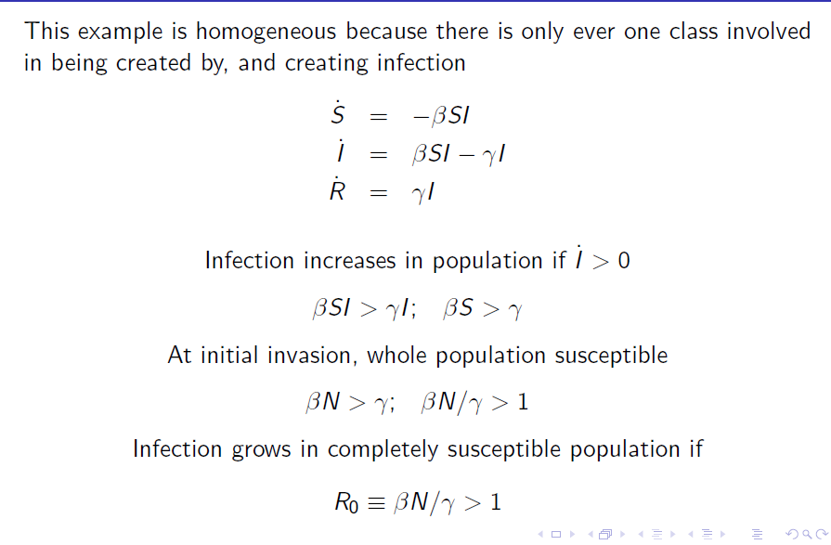
A Straightforward Example: SIR Model

Slide 5
A More Complicated Endemic Model
S
I
R
Notes:
R0=b/(r+u)
Something interesting here, but still intuitive: R0 is related to the “infectious” state. So u only shows up once for I.

Slide 6
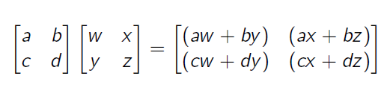
Some Basics of Matrix Algebra
Matrix: extension of vector (2-dimensional, m*n)
Square matrix: a matrix that has m=n
Trace (T): a+d (sum of diagonal elements)
Determinant (D): ad-bc (product of diagonal minus product of off diagonal)

Slide 7
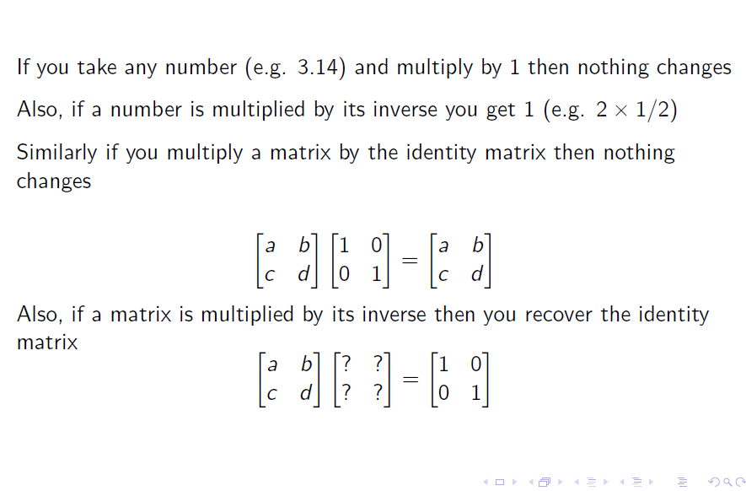

Slide 8
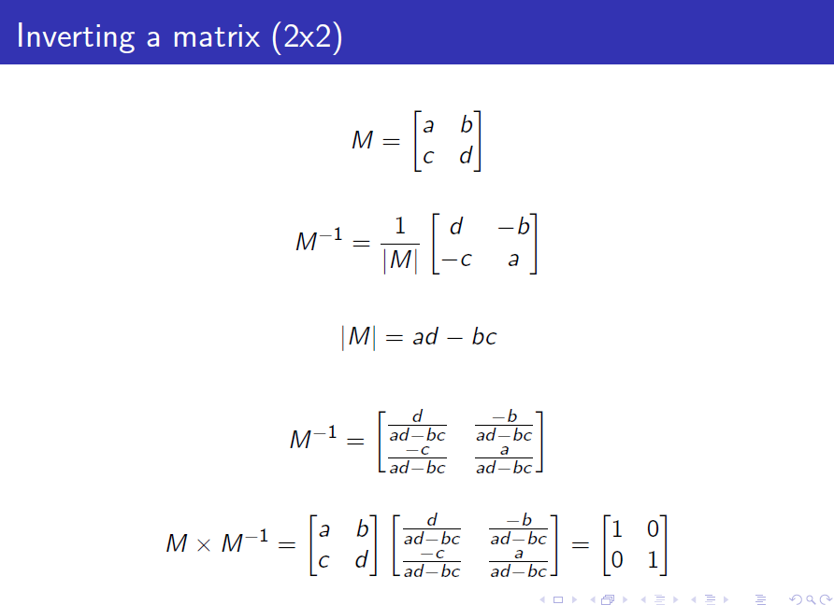

Slide 9
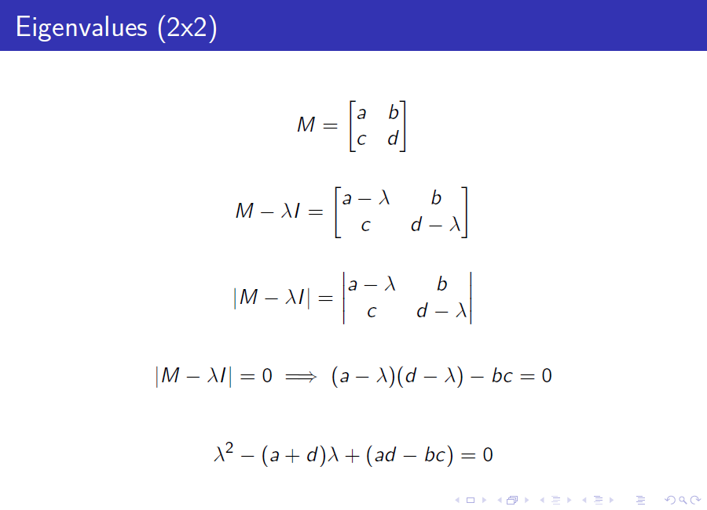

Slide 10
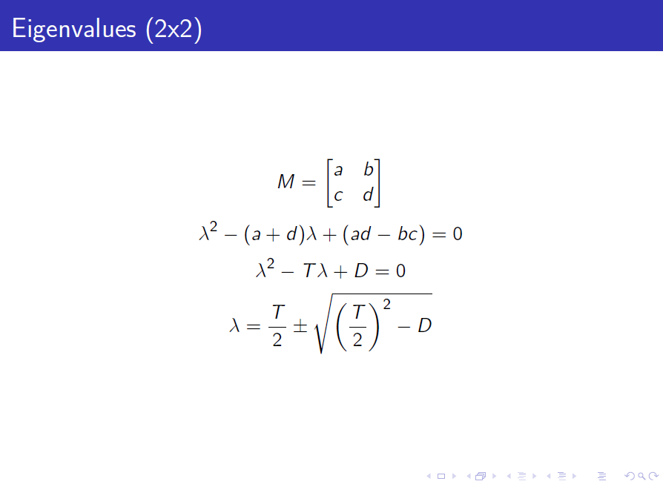

Slide 11
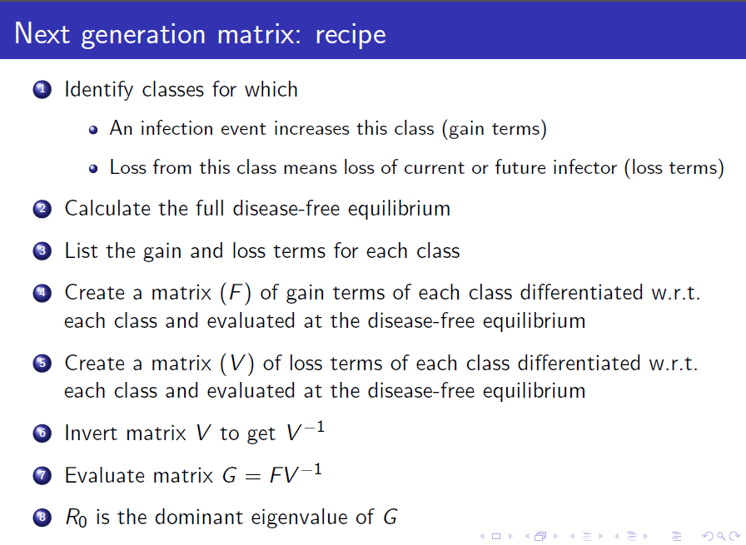

Slide 12
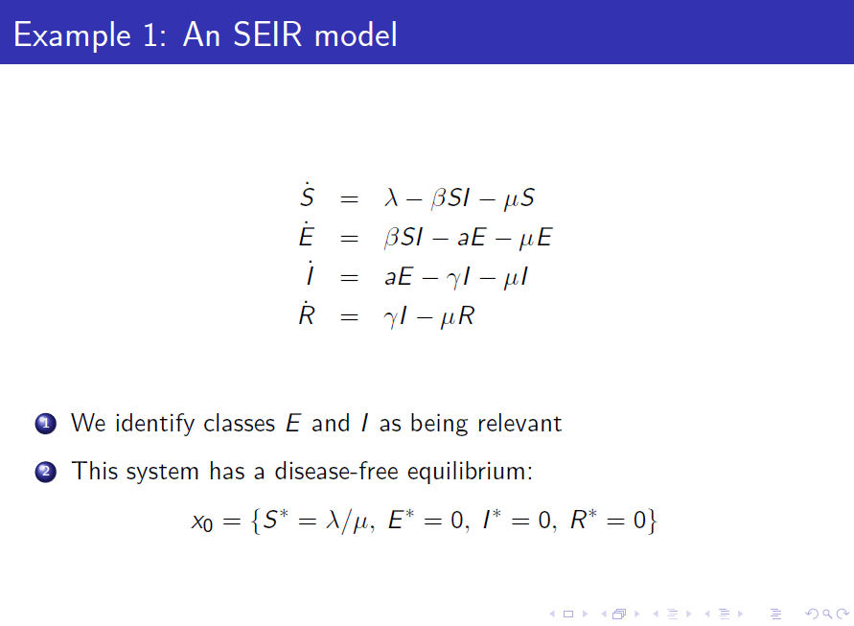

Slide 13
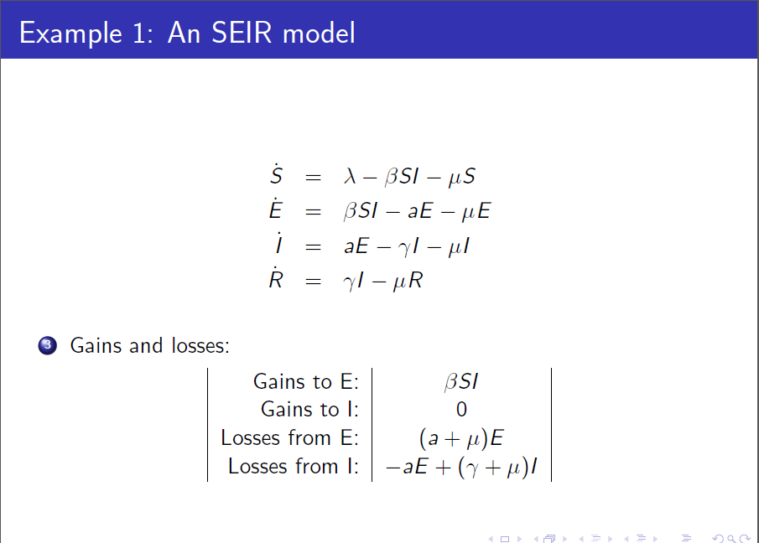

Slide 14
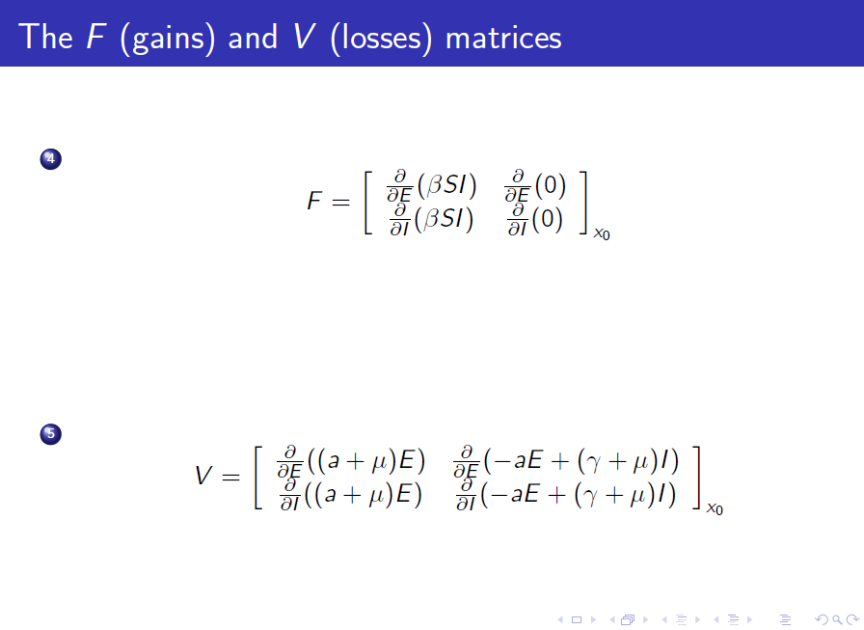

Slide 15
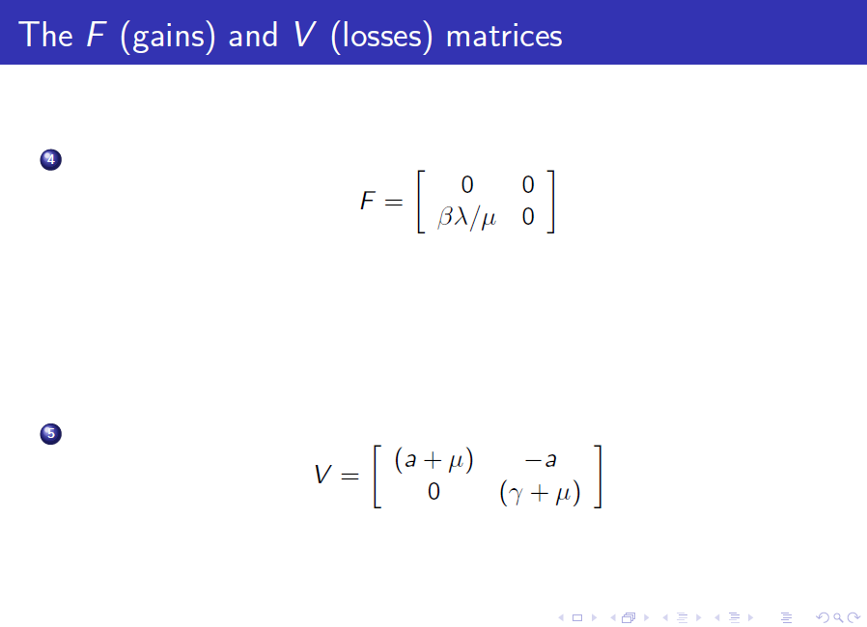

Slide 16
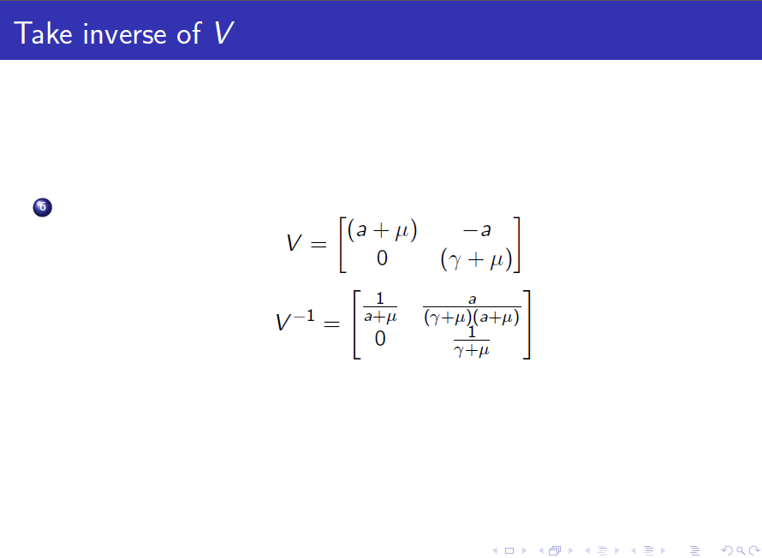

Slide 17


Slide 18
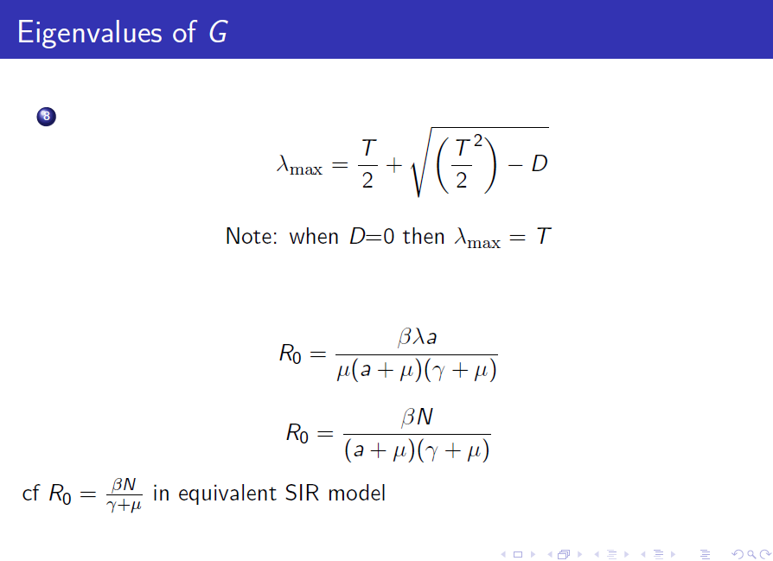

Slide 19
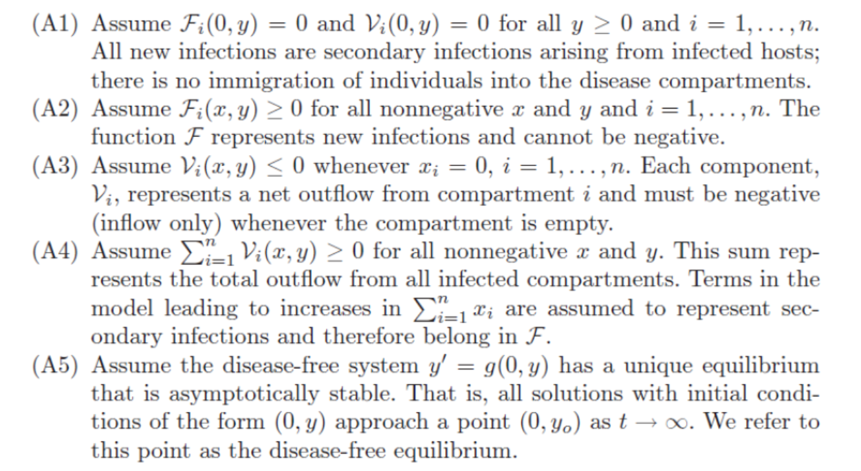
Some CAUTIONS

Slide 20
